Slide 1
Different Systems for Estimation of MARP Sizes

Slide 2
Session content
Why size estimates of the most at risk population important?
Different methods of estimation
Geographic mapping of HRGs: Current size estimation methods used in India
Group work

Slide 3
Onward transmission of HIV, HRGs and MARPs
Core groups
Female sex workers (FSWs)
Men who have sex with men (MSM)
Injecting drug users (IDUs)
Bridge populations
Clients of FSWs
Core

Slide 4
Uses of size estimates
Policy
Advocacy
Resource allocation
Planning the response
Programs
Planning interventions
Measuring program coverage
Assessing program effectiveness

Slide 5
Size estimation methods
Direct Methods
Census and Enumeration Methods
Population surveys
Indirect Methods
Multiplier methods
Capture –recapture methods
Network analysis (i.e. nomination, snowballing, respondent driven sampling or RDS)
PLACE (Priorities for Local AIDS Control Efforts) method
Geographic mapping

Slide 6
Census and enumeration

Slide 7
Census and enumeration (1)
Census counts every member of the HRG
Counting every FSW in a red-light area
Enumeration counts a sub-set of individuals selected from within a defined sample frame, and multiplies that number according to size and structure of sample frame.
Count the number of brothels
Count FSWs in a sample of brothel
Multiply the average number of FSWs per brothel from the sample to the number of brothels that exists in the area

Slide 8
Census and enumeration (2)
strengths
limitation
Straightforward
Less time-consuming and can give better results where geography and population is well-defined and visible
Well suited to count at the local level
Not well-suited for hidden populations, diverse geographic areas or where population of interest is scattered

Slide 9
Population survey methods

Slide 10
Population survey method (1)
A general population survey on a random and representative sample
Collect data on the risk-behaviour on which the estimate is to be based
Apply the survey estimate of prevalence of a behaviour to the current reference population

Slide 11
Population survey method (2): An example
The national survey conducted interviews in 8,000 men aged 15-49 year-old in a representative sample of households. The result shows that 12% of the respondents have bought sex in the last year.
The most recent census shows that there are 10 million men in that age bracket.
The estimated number of men who bought sex in the last year is 1.2 million
Estimate: 10,000,000* 0.12 = 1,200,000

Slide 12
Population survey method (3)
Strengths
Limitations
Robust methods of sampling and data collection
Can cover large geographic areas – states, nation
Requires large samples
Risk behaviours often are under-reported
In Karnataka, reported behaviours in polling booth surveys was used to estimate clients of FSWs

Slide 13
Multiplier methods

Slide 14
Multiplier methods
Multiplier methods rely on information from two sources that overlap in a known way:
population in contact with an institution or services
population at risk itself
Estimates are derived by multiplying the number of people who attend the institution by the reversed proportion of the population who say they attended over the same period.

Slide 15
Used in select IBBA districts
NGO multiplier
Different information was used in different districts depending on the quality of NGO records/reports
Registered with the program
Contacted by an outreach worker
Received new health card
Visited the clinic
Unique object multiplier
Unique (easily remembered) object distributed 1-2 weeks ahead of IBBA to population similar to the one that is going to be surveyed (“Labeled group”)
In IBBA, respondents were asked if they received this unique object
Source: National Interim Summary Report – India (October 2007), Integrated Behavioural and Biological Assessment, Round 1 (2005-07), Indian Council of Medical Research and Family Health International

Slide 16
The multiplier method: An example
1700 persons are registered with an FSW TI in past year
FSWs registered with the FSW TI
Estimated Number
of FSWs:
Multiplier: 1/.8=1.25
Estimate:
1700*1.25= 2125
80% of FSWs reported having registered with the FSW TI in past year
Sample of FSWs participated in IBBA

Slide 17
Multiplier methods: Issues
Requires good institutional record keeping and the right questions used in the survey instrument
Difficulty in finding data for institutions and populations that correspond with one another
Need to have clear consistent definitions between different data sources
The time reference period must be clear
Catchment area for the services or institutions must be clear, and ideally should be the same

Slide 18
Capture-recapture methods

Slide 19
Capture-Recapture Methods (1)
It is based on the principle that the member of a given population, if captured, marked and released back into that population will reappear in a second later sample.
The proportion of marked sample caught in the second sample represents the proportion that the original marked sample was to the total population.

Slide 20
Capture-Recapture Method (2)
The first capture
Fish were captured and marked
The second capture (Recapture)
Fish were released back

Slide 21
Capture-Recapture method (3)
An estimate team visits all cruising sites for male sex workers, counts all the men there, distributes some token
A week later, they revisit the sites, take another count of individuals, give a token to those who did not receive it earlier, and keep a count of those who had already received the token and those who did not receive it in the first round
The formula for estimation
N=(# in first capture x # in second capture) / # in both captures
95% confidence intervals can be constructed around the estimate

Slide 22
Capture-Recapture method (4)
Samples must be independent from one another; and not correlated
Positive correlation leads to an underestimate of true population size, by increasing the number of double-captures
Negative correlation leads to an underestimate of the population size, by decreasing the number of double-captures
Each member of the population should have an equal probability of being “captured”
Individuals identified in both captures must be correctly identified
“integrity of mark”
There should be no major in-migration or out-migration from the population between the initial and second captures

Slide 23
Capture-Recapture Methods : An Example
Estimate of N = C1*C2/M
N = (972*845)/371=2214
FSWs in Mysore city
FSWs distributed lottery tickets in the first capture
(c1=972)
FSWs
contacted
in the second capture (c2=845)
371 matches

Slide 24
Multiple samples of capture-recapture – Schnabel model
Where M_{t}=number of unique individuals in the population just before the i^{th} sample is drawn
C_{t}=number of unique individuals caught in the i^{th} sample
R_{t}=number of recaptured individuals drawn in the i^{th} sample

Slide 25
Network analysis

Slide 26
Nomination methods (1)
Start at the tip of the iceberg; the small but visible fraction of a larger hidden population
These individuals are contacted and asked to provide the contacts for other individuals who share their risk behaviour
These individuals are again contacted and similar lists of contacts are generated
Variations - chain referral method and snowballing

Slide 27
Nomination methods (2)
Good identifying information is necessary to remove duplicates
Hard to understand how representative the “core” group of the overall risk population
Diverse initial sample and at least three waves of referral is recommended

Slide 28
Respondent Driven Sampling (RDS)
RDS is an enhancement of chain referral sampling methods (CRS)
It’s designed to sample “hard to reach” populations
It reduces biases associated with chain-referral methods using dual system of structured incentives : peers recruit their peers
It can recruit a large sample with fewer resources

Slide 29
RDS to estimate IDUs in Bangkok, 2003-04
Bangkok Metropolitan Administration & Thailand-US CDC Collaboration
Adapted from presentation by Orratai Rhucharoenpornpanich

Slide 30
Sampling Process
15 initial seeds were selected form 4 sites
10 men and 5 women
14 in-treatment IDUs and 1 out-of-treatment IDU
Each seed in wave “0” was supplied with 3 unique recruitment coupons
Recruiters were paid incentive money for the interview and received an additional payment for each person they successfully recruited
Bonus payments were given for the recruitment of female and young (<20 yrs) IDU

Slide 31
Definitions
Injecting drug users: persons who injected drugs in previous 6 months
In-treatment IDU : IDU attending any drug clinics during the period of RDS operation (October 01, 2003 - March 31, 2004)
Out-of-treatment IDU: IDU not-attending any drug clinics during the period of RDS operation
Notes:
Definitions used in this study were:

Slide 32
Steps in recruitment of participants
Recruits presented their coupons to project staff
Staff assessed whether recruits have injected in the past 6 months using a screening questionnaire
Informed consent was taken for participation and for becoming a recruiter
The recruiter was reimbursed for successfully recruiting and educating peers; each participating IDU was given the opportunity to become recruiter

Slide 33
Data requirements for size estimates
Two pieces of essential information were collected:
Coupon referral data (who recruited whom)
Self –reported network size : How many injectors do you know personally by first name or nick name with whom you have had contact in person, by phone, or some other way in the past two years? These could include sexual partners, friends, or others.

Slide 34
Size estimates of IDU population
Two data sets were used
Population Proportion Estimates (PPE)
Institutional Data
Number of IDUs currently attending drug treatment clinics during RDS operation (1 October 2003 – 31 March 2004) = 1,981
Special software RDSAT (Respondent Driven Sampling Analysis Tool) was used

Slide 35
Core estimation formula
Sba Nb
PPE (b) =
Sba Nb+Sab Na
(0.386 x 4.850)
PPE (in-treatment IDU) =
= 0.551
(0.386 x 4.850)+(0.290 x 5.238)
Where :
PPE = Population Proportion Estimates (PPE)
b = In-treatment IDUs
Sab = proportion of population (a) recruited by population (b)
Sba = proportion of population (b) recruited by population (a)
Na = mean network size of known IDUs reported by population (a)
Nb= mean network size of known IDUs reported by population (b)

Slide 36
Size Estimates of IDU population
Estimated number of IDU population :
Number of IDUs currently attending drug clinics / PPE of the in-treatment IDUs
1,981
.551
= 3,595
Estimated number of IDUs in Bangkok during October 2003- March 31, 2004 would be 3,595

Slide 37
RDS : Pros vs Cons
Pros :
Access more “hard-to-reach” persons (broad coverage)
Can recruit a large sample with fewer resources
Easy to implement and fewer staff needed
Cons :
Duplicate respondents
Need to verify IDU membership
Need to use special software to do analysis / to identify duplication

Slide 38
PLACE Method
Measure Evaluation

Slide 39
PLACE method
Objectives
To identify geographic areas most likely to contain key HIV transmission networks;
To assess HIV prevention program coverage among groups most likely to acquire and transmit HIV; and
To provide specific actionable recommendations to address critical gaps in prevention programming.

Slide 40
The 5-steps
A national PLACE Steering Committee reviews the HIV epidemic and identifies Priority Prevention Areas (PPAs) where HIV prevention needs are most acute.
Local PLACE committees within each PPA take charge of local PLACE implementation. Interviewers conduct short surveys of 300-500 community informants to identify all local public venues (such as hotels, hostels, parks and bars) where people meet new sexual partners and where IDUs socialize.
Trained interviewers visit all venues identified in Step 2 and characterize each in terms of the type of venue, the type and number of people who visit the venue (including youth, IDUs, MSM, sex workers, and clients), the existence of any current HIV/AIDS prevention programs at the venue, and the feasibility of future on-site prevention efforts.
A representative sample of patrons is interviewed regarding their socio-demographic characteristics, their sexual and injecting drug use behaviours, and their exposure to HIV prevention programs, including HIV testing and condom promotion.
The findings are locally analyzed and interpreted in an action plan to address prevention gaps.

Slide 41
A Geographic Approach to Mapping High Risk Locations for Scaling Up HIV Prevention Program in Karnataka

Slide 42
Mapping: The purpose
To identify the location
To estimate the size
To understand the operational typology
Key at risk population groups
female sex workers,
high risk men who have sex with men, and
injecting drug users

Slide 43
Mapping: The approach
Geographic mapping
Map locations instead of risk populations
Not to over-burden the mapping with a lot of information
Keep the method simple and rapid
Map locations and hot spots in urban areas where high-risk activities take place
Profile these locations and hot spots to provide population estimates and operational typology

Slide 44
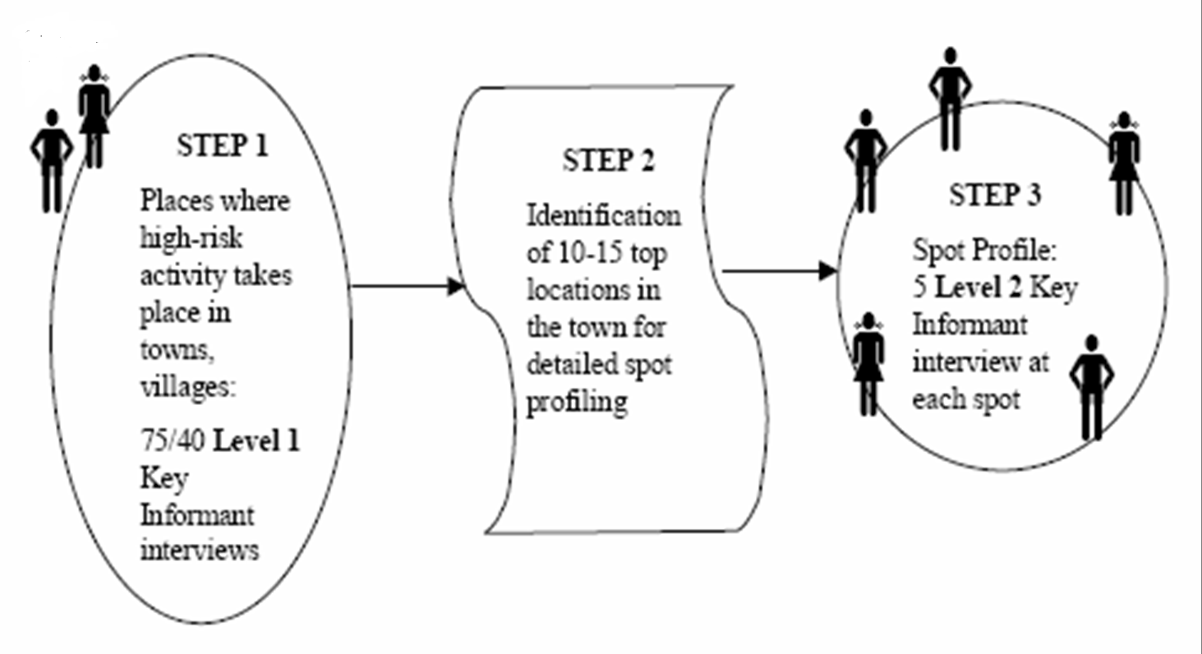
Mapping: The method

Slide 45
Step 1: Finding locations
Interview about 40-70 Key informants per town
Auto drivers, panwallas, coolis, hamalis, transportation workers, shop-keepers, lodge owners, vegetable/ fruit/ flower vendors, students, health care providers, drug stores
Ask about
Where do the female sex workers operate in the town?
Where do men who have sex with men operate in the town?
Where are the injecting drug users in the town?
Where are the traditional groups at risk such as Devadasis, Jogatis, and Jogapps in the town?
Type of these locations – residential, commercial, entertainment, official, educational, open spaces, etc.)

Slide 46
Step 2: Short listing locations
Merge different locations that are geographically contiguous, and the ones that have duplicate names
Do a frequency tally of locations by the number of Key Informants reporting that location
Choose top 10-15 locations for detailed profiling

Slide 47
Step 3: Spot profiling
Interview a minimum of 5 Key Informants closely associated with the risk activity in the spot
Female sex worker /MSM /Hijra, a madam/ Gharwali, a Lodge/ Dabha manager, a pimp
Collect information on:
Size of the risk population in the spot (on a typical day, and weekly/seasonal variations)
Type of operation (seeking risk versus taking risk)
Approximate client volume (in case of FSW spots)
Triangulate and firm up the estimation and typology

Slide 48
Mapping: Coverage and process
Coverage
Covered 198 towns in 26 districts + 49 zones in Bangalore Urban district
Process
The entire state was divided into three zones
Each zone had a team of 20 persons including 15 field researchers, 2 supervisors, 2 data collators and a helper
Each team mapped a town in about 3-5 days

Slide 49
Mapping: Results
A total of 76, 762 key informants interviewed
A total of 2,043 locations and 7,756 spots have been mapped
A total of 73,410 persons with high risk activities are estimated, including 34,810 in Bangalore

Slide 50
Female sex workers

Slide 51
Sex work type: FSWs

Slide 52
Using mapping data for planning
The mapping data
Helped to prioritize the towns for intervention within a district
Provided names of locations and hot spots where the community mobilization and rapport-building could be initiated

Slide 53
Prioritizing intervention towns based on broad mapping: an example
The mapping estimated a total of 1,736 FSWs in the district, covering all the 9 towns.
However, by having the TI in just 2 towns (Shimoga and Bhadravati) would promise a coverage of 65% of the FSWs estimated in the district
By covering the other two towns (Sagar and Jog Falls) which are located close to each other, the promised coverage of FSWs is over 80% of the estimated FSWs in the district.

Slide 54
Validation of mapping estimates
The NGOs implementing the program in the district carried out detailed situation and needs assessment, including validation of the number of FSWs estimated by mapping
Site validation was done during the first 6 months of programming, after building rapport with the community and initiating basic outreach and clinical services
Town-wise, the validated estimate differed from the mapped estimate by only about 5-10%

Slide 55
Limitations
Did not provide data on site “turn over”, mobility between hotspots
Tended to under-estimate the MSM population

Slide 56
Mapping and size estimation of HRGs
NACP III

Slide 57
Features of mapping under NACP III
Provides where and how many for core HRGs (Broad mapping)
Additionally, information on
Site characteristics – how hot is the spot?
Service map – Seva chitram
Vulnerabilities – Why is it so?
Sex life or client profile
Uses community members
Uses participatory methods
Began the process of community mobilization

Slide 58
Broad map
Purpose
provides mapping teams with a geographical and social overview of a site.
Participants
This method is to be used with the general population as well as the key populations in the site.
Process
Start by asking general questions about the site. Spread chart paper on the ground, hand out sketch pens, and request the participants to draw the geographical outline of the area.
Request participants to mark the important landmarks in the area. Whilst marking landmarks, services such as government hospitals, popular dispensaries, and NGOs can also be marked on the emerging map.
Next, ask participants to mark the specific locations or hotspots where key populations tend to congregate.
Whilst the participants draw the map, ask them probing questions to generate information on categories of key populations at different hotspots. Note key information in a field diary.
Ask specifically about the mobility patterns of key populations—migration to and from the site as well as within the site. Obtain information on who migrates from where, which places they come from, which places they go, why they do so, when they do so, and in what numbers.

Slide 59
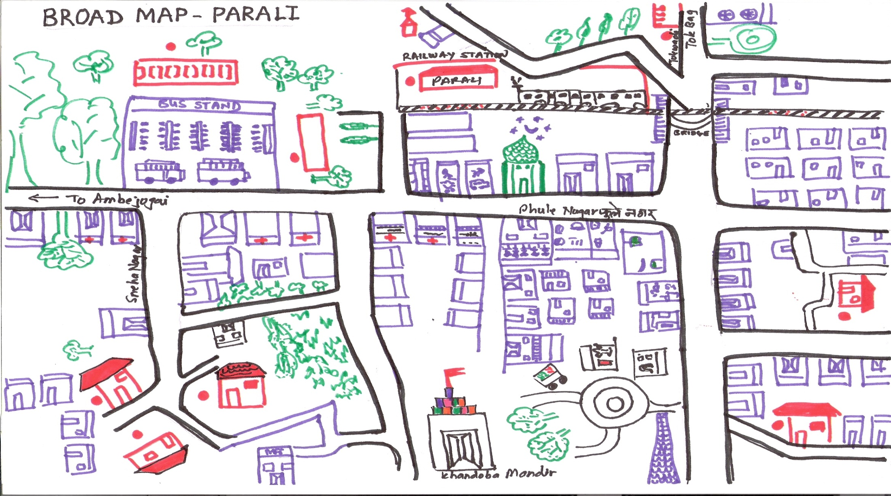
Broad map
Example of a broad map
A hotspot is a specific public location where key populations cruise, solicit clients, are picked up, interact with other key populations, buy/use drugs, and/or have sex.

Slide 60
Numbers and trend mapping or “How hot is the spot?”
Purpose
To estimate the number of members of each different key population group and to find out how often they visit the hotspots.
Participants
Visible and self-identified key populations.
Process
Ask the group to draw a map of the hotspot, including any local landmarks to orient the map.
Ask the group to rank the hotspot using symbols for “high”, “medium”, and “low” to indicate the level of risk of HIV/STI infection amongst the key populations within the hotspot.
Ask the participants why they have marked the hotspot high, medium, or low.
Ask participants to suggest general changes in order to downgrade a high hotspot to a medium or low hotspot.
Ask participants to estimate the number of key population members from each category who visit the hotspot on an average day.
Ask participants to draw a clock (or a line representing 24 hours of a day) and indicate the times of day when the key population members they mentioned might be found at the hotspot..
Ask participants to draw a line indicating seven days of a week and ask them to similarly mark the line to indicate fluctuations during a week.
Ask them to place symbols next to the hotspot(s) to indicate events or festivals in a year when the number might significantly go up or down.

Slide 61
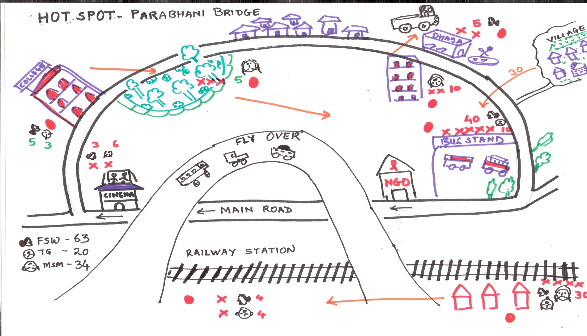
Example of “how hot is the spot”
Example of “how hot is the spot?”

Slide 62
Seva chitram or services mapping
Purpose
To assess the availability of services within the site and key populations’ access to them.
Participants
Visible and self-identified key populations.
Process
Ask the participants to identify any places or people on their map from which the key population group to which they belong can access HIV/STI prevention and treatment.
Ask the participants to mark the following next to each intervention:
What the service provides.
How the service helps reduce the risk of HIV/STI infection.
Ask the participants to rank the service as “high”, “medium”, or “low” according to how accessible it is to key populations like themselves. Also ask them to note how often they access or utilise each service: “often”, “sometimes”, or “never”.
Ask the participants to identify factors that motivate them to use the services marked high or medium (e.g., distance, cost, behaviour of service providers, confidentiality, effectiveness of services provided, availability, timing).
Now ask them to discuss the services ranked low. What could be done to make these vital services more accessible to key populations like themselves?

Slide 63
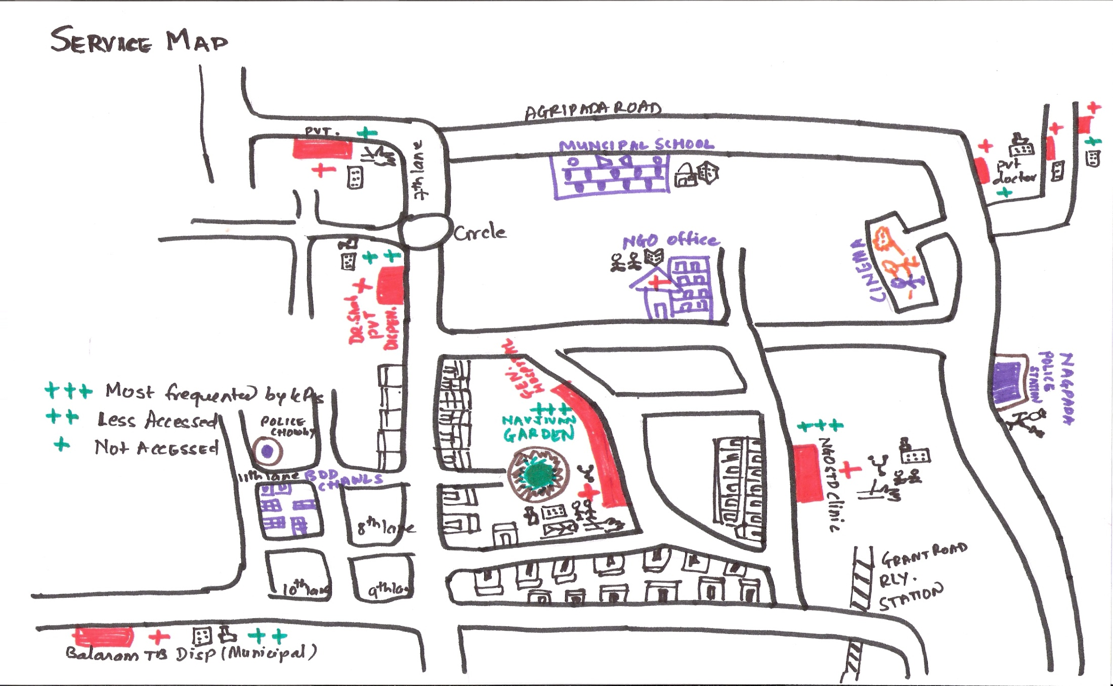
Example of service map
Example of Service Map

Slide 64
“Why is it so?”
Purpose
Will help key populations analyse the range of risk factors that increase their susceptibility to HIV/STI transmission.
Participants
Visible and self-identified key populations.
Process
Ask participants to identify the types of behaviours that put people at risk of HIV/STI infection.
Pick any one of the risk behaviours.
Ask participants to mark this risk behaviour on the flipchart with a symbol drawn inside a circle.
Ask “Why is it so?” Invite them to draw and/or write the reasons for the risk behaviour in balloon call-outs.
Persistently ask “Why is it so?” Add reasons in connecting balloons until participants can think of no more.

Slide 65
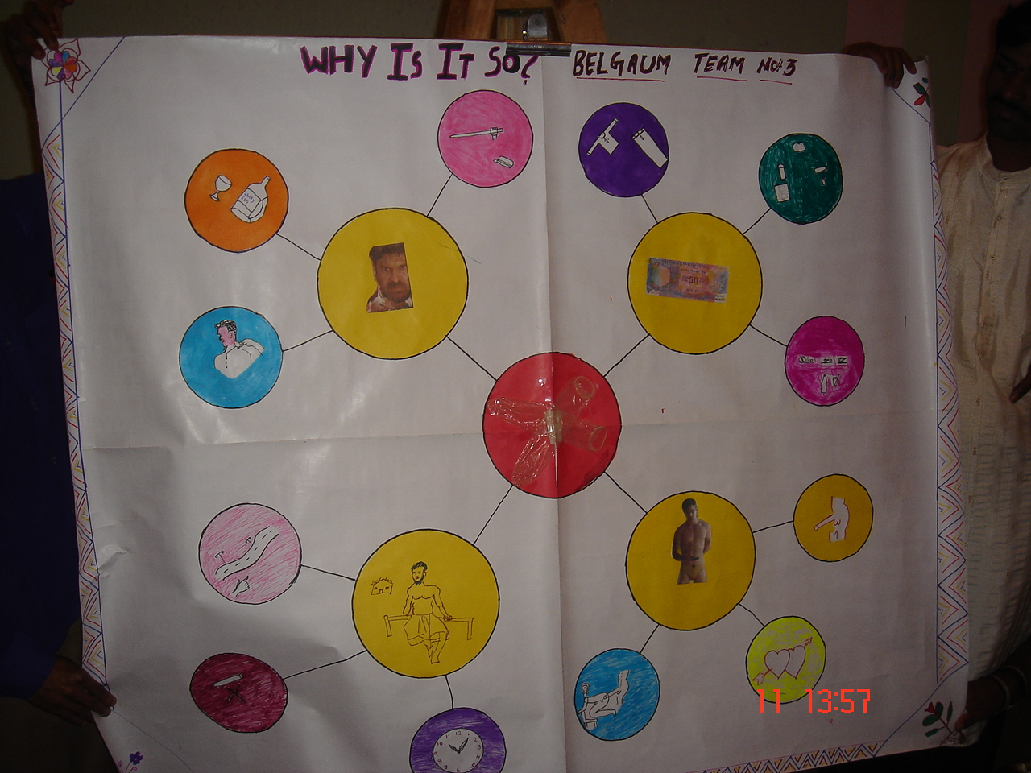
Example of “Why is it so?”

Slide 66
Sex life or client profile
Purpose
Is used to explore the number and range of sexual partners that a key population member has. It also indicates the kinds of sexual acts that key populations usually practice with their sexual partners. This helps estimate the extent of penetrative sex and the project demand for condoms.
Participants
Visible and self-identified key populations.
Process
Administer this method on a one-to-one basis with individuals from different key population categories.
Ask the key population member to draw a figure at the centre of the flipchart paper that represents him or herself.
Next, ask the participant to draw figures around this figure that represent his/her sexual partners. Call upon him/her to describe the partners (without naming them).
Who are they? Where do they come from? What do they do? How old are they? How are they related to the key population? How they met?
Then, ask the key population member to indicate next to each partner’s figure the number of times he/she practiced sex with that person in the previous week, as well as the nature of the sexual encounter (anal, vaginal, oral, nonpenetrative, etc.).

Slide 67
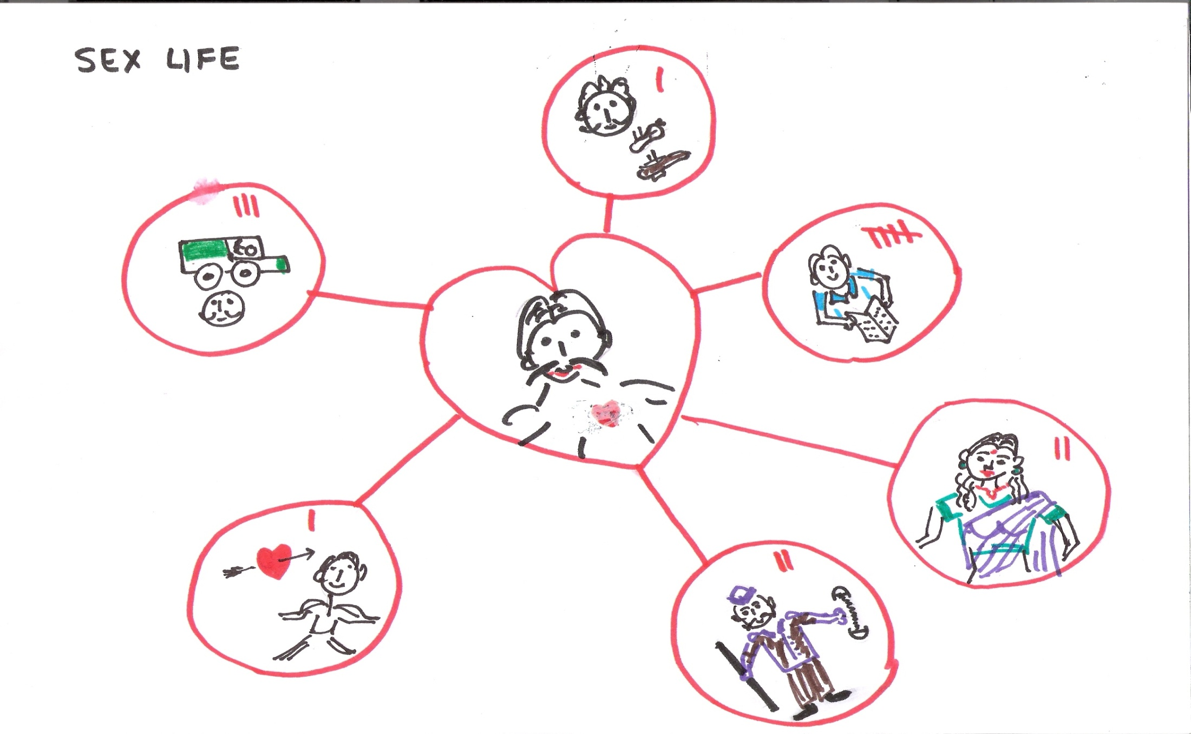
Example of sex life
An example of Sex Life

Slide 68
Estimates of FSWs

Slide 69
Ratio of estimated FSWs to urban adult (15-49 yrs) population
The ratio of estimated number of FSWs per 1,000 adult urban males ranges from <5 in Puducherry, Gujarat, Tamil Nadu, Madhya Pradesh and Rajasthan to over 20 in Manipur, Nagaland and Tripura

Slide 70
Distribution of districts by size estimation and ratio of FSWs to adults
Ratio of FSWs to 1000 urban adults | Estimated number of FSWs
 | 10000+ | 5000-9999 | 1000-4999 | <1000 | Total
>10 | 2 | 7 | 51 | 71 | 131
5-9 | 3 | 2 | 60 | 52 | 117
<5 | 2 | 5 | 51 | 207 | 265
Total | 7 | 14 | 162 | 330 | 513

Slide 71
Challenges of mapping under NACP III
Difficulty in identifying community members in states/districts/cities/towns with no prior interventions among HRGs
Disagreements between the “program” estimates and “independent mapping team” estimate in states/districts/cities/towns with existing interventions among HRGs

Slide 72
Mapping FSWs in Rural Areas
Case study of Karnataka

Slide 73
Rapid Rural Assessment
All villages with 500+ populations (11,052 villages) in the 12 Samastha districts were visited by a team of trained researcher and an FSW
Compiled information on a set of 14 indicators for each village through KI interviews
Office-bearer of Gram Panchayat, Anganwadi teacher, ANM, School teacher, Owner of petty shop/grocery/ tea stalls, Member of Mahila Mandals/Sthree Sakti Groups, Member of Yuvak Mandals, Local STD booth operators
In villages having sex workers, at least 3 FSWs were interviewed by the FSW in the mapping team
The indicators included:
Estimated number of FSWs staying and doing sex work in the village (q12a)
Estimated number of FSWs staying in the village but practicing sex work outside the village (q12b)
Estimated number of FSWs from the village staying and doing sex work outside the village (q14

Slide 74
Regional variations in female sex work (1)
The rapid rural assessment in the districts indicate that rural female sex work varies by region
Northern Karnataka (Bagalkot, Belgaum, Bellary, Bijapur, Dharwad, Gulburga, Koppal, and Raichur) has a somewhat greater proportion of FSWs to population than its Southern counterpart (Bangalore Rural, Davanagere, Hassan, Mysore and Tumkur) – 8.5 per 1,000 adult females versus 7.8 per 1,000 adult females

Slide 75
Regional variations in female sex work (2)
A greater proportion of villages in Southern Karnataka have no FSWs (50% compared with 39%)
On the other hand, a greater proportion of villages in Northern Karnataka have 10+ FSWs (13% compared with 7%)
Female sex work is more dispersed in Southern Karnataka than in the North
60% of the FSWs in Southern Karnataka are in 45% of the villages whereas 54% of the FSWs in Northern Karnataka are concentrated in 13% of the villages

Slide 76
Rural mapping under the Link Worker Scheme
Under GFATM-7, NACO has adopted a modified version of the mapping in rural areas for the Link Workers Scheme
Instead of all villages in the district, mapping is carried out in select 100 largest (population, 2001) villages

Slide 77
Features of a “good” size estimation
Where and how many?
Estimates for the lowest geographic unit, aggregated to the larger units
Distribution by typology
By place of solicitation among FSWs
By gender identity among MSM
By types of drugs and modes of intake among the IDUs
Turn-over or extent of duplication in case of small area estimates
Simple, and is not loaded with information that could be gathered during intervention
Scope for validation/verification
The process involves community members
Takes into account existing program coverage

Slide 78
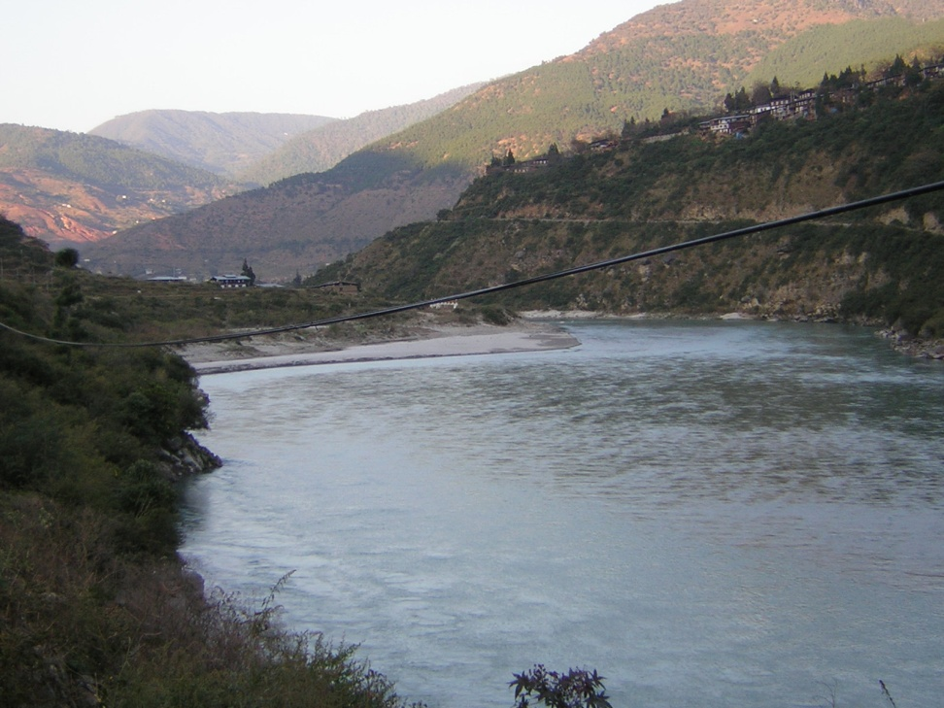
Sexual Behaviours and Networks in Thimphu, Bhutan: A Rapid Assessment
Ministry of Health, Bhutan
and
Centre for Global Public Health,
University of Manitoba, Canada

Slide 79
Objectives
To identify and characterize the key venues and locales in Thimphu where people meet new sexual partners
To identify and characterize non-location based ways in which people meet new sexual partners, especially commercial sex partners
To describe sexual behaviours and networking patterns at key venues and locales in Thimphu

Slide 80
Venue profile
205 venues (including public places) where people congregate were profiled
10 field researchers – trained by MoH and CGPH
Key informant interviews – at least 2 KIs, including the manager and a patron
Structured interview questionnaire
Types of services offered, peak days and timings
Total number of men and women visiting the venues on typical and peak days
Total number of men and women who seek sexual partners at the venue, including the female sex workers
Availability of condoms at the venues
Completed in about 2 weeks

Slide 81
Risk profile of individuals visiting venues
Of the 205 venues profiled, a sample of 56 venues selected for the survey
Venues with 5 or more FSWs visiting the venue on a typical day or 10 or more individuals seeking sexual partners (men seeking women, women seeking men plus men seeking men)
A total of 480 patrons targeted, as per the proportion of men and women seeking sexual partners at these venues; 485 interviewed
Structured interview questionnaire
Socio-demographic characteristics
Sexual partners in past 6 and 12 months
Last 3 sexual partners
Paying/paid sexual partners
Condom accessibility and use
Self-reported STIs in past 12 months
10 field researchers, completed in about 4 weeks

Slide 82
Group work (45 minutes)
Participants break into 3 groups
Group 1 – for estimating FSWs
Group 2 – for estimating MSM
Group 3 – for estimating IDUs
Each group discusses and chooses one method for estimating the size of the respective target group(30 minutes)
Each group presents (5 minutes for each group) the method of their choice and considerations for choosing the method

